Slide 1
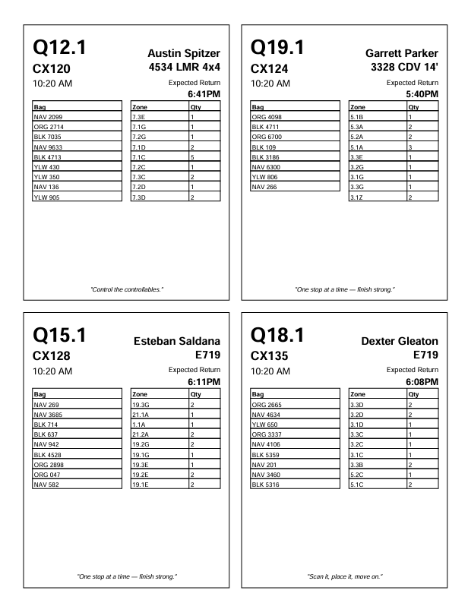
TAVBLE 1 – “BAGS” – Just the bag code “GRN056”, these are listed by the sort order from the route sheet
TABLE 2 “OV” – List the Zone and QTY of the oversize packages as shown on the route sheet

